Slide 1
Group Project # 1
Contributors:
Mona Buttu
Kimmy Zhang
Sushaine Goyal
Pasquale Pellicano

Slide 2
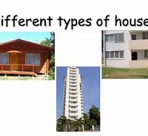
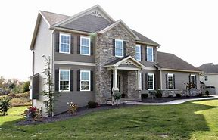
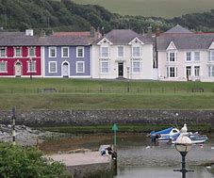
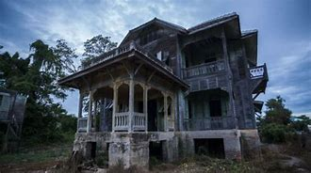
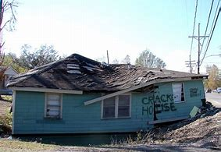

Scope
Real Estate Market in the G.T.A.

Slide 3
Describe the core message or hypothesis for your project.
How active is the Real Estate Market in Toronto and explain variances between the different areas of the city.
From the West:
Etobicoke
West Toronto
York
North York
Downtown Toronto
Central Toronto
East York
Scarborough

Slide 4
Describe the questions you and your group found interesting, and what motivated you to answer them
What are the drivers that differentiate the changes in price based on the area. (this will be relevant if we have the data about amenities and other indicators)
Volume of active listings by area
Average price by area
Criminality Rate as it is compares to the different areas of the city(this will be relevant if we have the data about the crime rate)

Slide 5
Summarize where and how you found the data you used to answer these questions
API call to Realtor.ca for the listings
API Call to the Police Database for the criminal activities
FSA code from Canada Post downloaded in a csv file

Slide 6
Describe the data exploration and cleanup process (accompanied by your Jupyter Notebook) Describe the analysis process (accompanied by your Jupyter Notebook)

Slide 7
Thank you!!!!
Enjoy the video
Some thought on Data Analytics

